Slide 1
Learning Objective
To learn the difference between a Bachelor of Arts and a Bachelor of Science major.
Agenda:
Announcements
Presentation

Slide 2
Announcements
Weds. Sept. 16th Student council apps due
Tues. Sept. 29th 11th Grade Parent Meeting
Weds. Sept. 30^{th-} Virtual B.E.S.T. College Night 6:30-8:30 PM

Slide 3
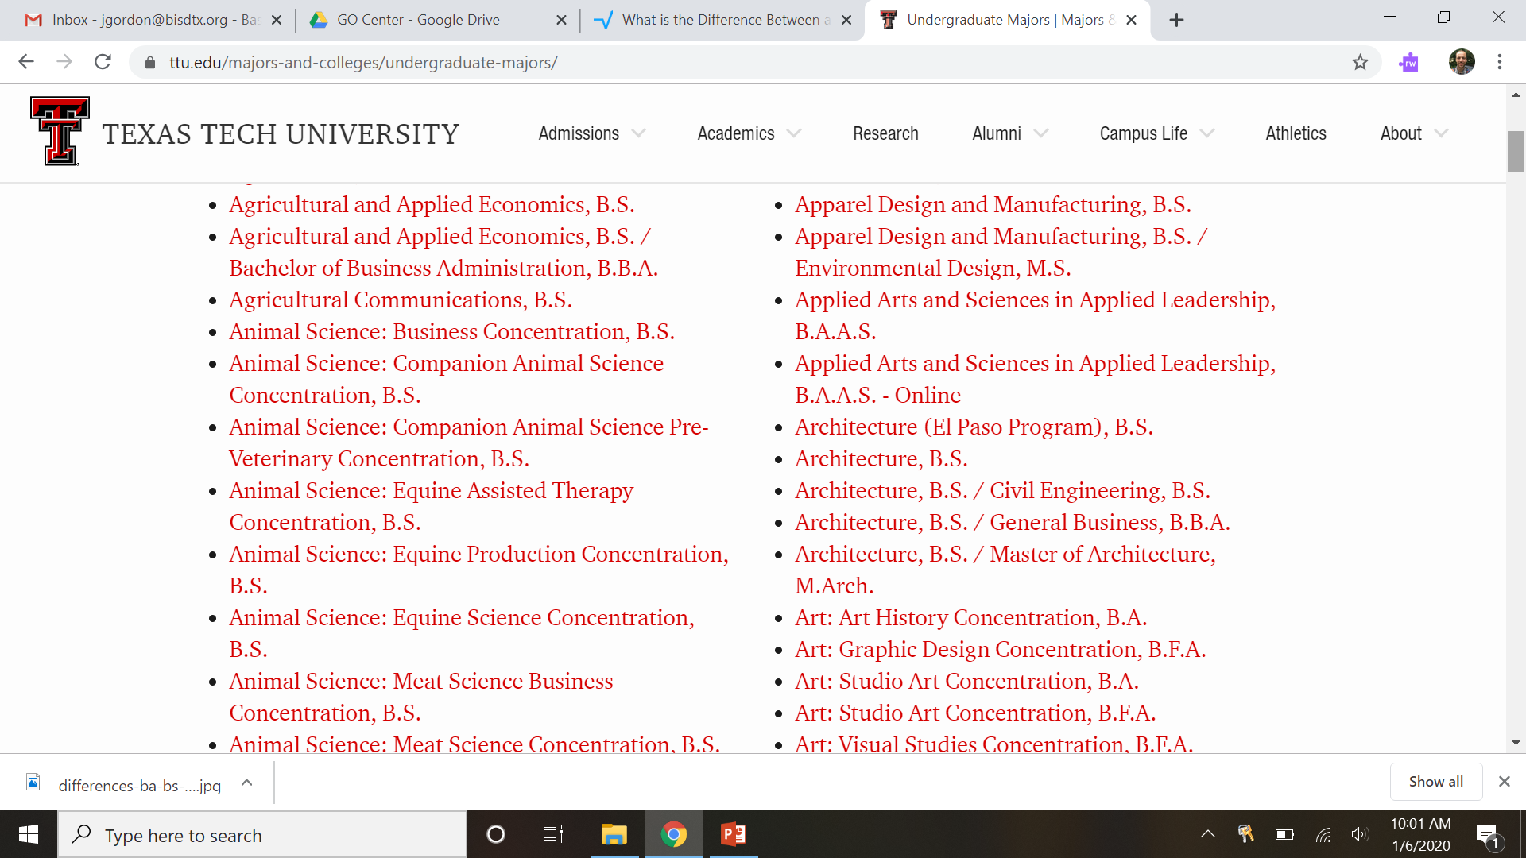
Difference between BS and BA
Most majors are divided into either a Bachelor of Science or a Bachelor of Arts degree. Some majors can have both, but this is uncommon eg Psychology and Business.
The main difference is the focus of the coursework required.
Below is a screenshot of a list of majors from Texas Tech University.

Slide 4
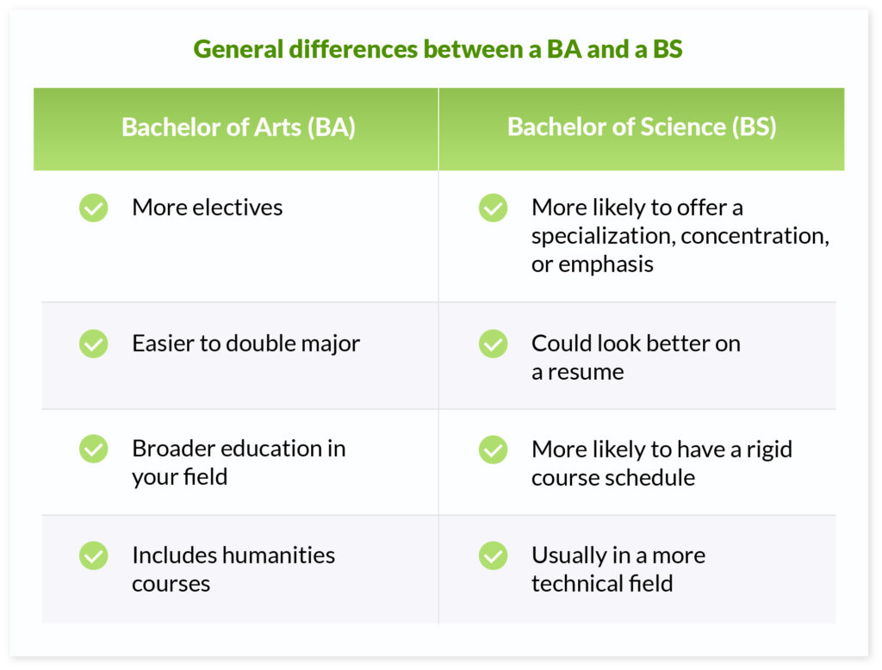
General Differences between a BA and a BS

